Slide 1

Chapter 22 – Multithreading

Slide 2

Chapter Goals
To understand how multiple threads can execute in parallel
To learn to implement threads
To understand race conditions and deadlocks
To avoid corruption of shared objects by using locks and conditions
To use threads for programming animations

Slide 3
Running Threads
Thread: a program unit that is executed independently of other parts of the program.
The Java Virtual Machine executes each thread in the program for a short amount of time.
This gives the impression of parallel execution.
If the computer has multiple CPUs, some of the threads can run in parallel, one on each processor.

Slide 4
Running a Thread
Implement a class that implements the Runnable interface:
public interface Runnable
{
void run();
}
Place the code for your task into the run method of your class:
public class MyRunnable implements Runnable
{
public void run()
{
Task statements.
. . .
}
}

Slide 5
Running a Thread
Create an object of your subclass:
Runnable r = new MyRunnable();
Construct a Thread object from the Runnable object:
Thread t = new Thread(r);
Call the start method to start the thread:
t.start();

Slide 6
Running a Thread
A program to print a time stamp and “Hello World” once a second for ten seconds:
Fri | Dec | 28 | 23:12:03 | PST | 2012 | Hello, | World!
Fri | Dec | 28 | 23:12:04 | PST | 2012 | Hello, | World!
Fri | Dec | 28 | 23:12:05 | PST | 2012 | Hello, | World!
Fri | Dec | 28 | 23:12:06 | PST | 2012 | Hello, | World!
Fri | Dec | 28 | 23:12:07 | PST | 2012 | Hello, | World!
Fri | Dec | 28 | 23:12:08 | PST | 2012 | Hello, | World!
Fri | Dec | 28 | 23:12:09 | PST | 2012 | Hello, | World!
Fri | Dec | 28 | 23:12:10 | PST | 2012 | Hello, | World!
Fri | Dec | 28 | 23:12:11 | PST | 2012 | Hello, | World!
Fri | Dec | 28 | 23:12:12 | PST | 2012 | Hello, | World!

Slide 7
GreetingRunnable Class
public class GreetingRunnable implements Runnable
{
private String greeting;
public GreetingRunnable(String aGreeting)
{
greeting = aGreeting;
}
public void run()
{
Task statements
. . .
}
}

Slide 8
run Method
Loop 10 times through task actions:
Print a time stamp. Print the greeting. Wait a second.

Slide 9
run Method
To get the date and time, construct a Date object:
Date now = new Date(); System.out.println(now + " " + greeting);
To wait a second, use the sleep method of the Thread class:
Thread.sleep(milliseconds)
Sleeping thread can generate an InterruptedException.
Catch the exception. Terminate the thread.

Slide 10
run Method
public void run()
{
try
{
Task statements.
}
catch (InterruptedException exception)
{
}
Clean up, if necessary
}

Slide 11
section_1/GreetingRunnable.java
1 import java.util.Date;
2
3 /**
4 A runnable that repeatedly prints a greeting.
5 */
6 public class GreetingRunnable implements Runnable
7 {
private static final int REPETITIONS = 10;
private static final int DELAY = 1000;
10
11
12
13
14
15
16
17
18
19
20
21
22
23
24
25
26
27
28
private String greeting;
/**
Constructs the runnable object.
@param aGreeting the greeting to display
*/
public GreetingRunnable(String aGreeting)
{
greeting = aGreeting;
}
public void run()
{
try
{
for (int i = 1; i <= REPETITIONS; i++)
{
Date now = new Date();

Slide 12
29
30
31
32
33
34
35
System.out.println(now + " " + greeting); Thread.sleep(DELAY);
}
}
catch (InterruptedException exception)
{
}

Slide 13
Start the Thread
First construct an object of your Runnable class:
Runnable r = new GreetingRunnable("Hello World");
Then construct a Thread and call its start method:
Thread t = new Thread(r); t.start();

Slide 14
section_1/GreetingThreadRunner.java
1 /**
2 This program runs two greeting threads in parallel.
3 */
4 public class GreetingThreadRunner
5 {
6 public static void main(String[] args)
7 {
GreetingRunnable r1 = new GreetingRunnable("Hello");
GreetingRunnable r2 = new GreetingRunnable("Goodbye");
Thread t1 = new Thread(r1);
Thread t2 = new Thread(r2);
t1.start();
t2.start();
14 }
15 }
Program Run:
Wed Apr 15 12:04:46 PST 2015 Hello
Wed Apr 15 12:04:46 PST 2015 Goodbye
Wed Apr 15 12:04:47 PST 2015 Hello
Wed Apr 15 12:04:47 PST 2015 Goodbye
Wed Apr 15 12:04:48 PST 2015 Hello
Wed Apr 15 12:04:48 PST 2015 Goodbye
Wed Apr 15 12:04:49 PST 2015 Hello
Wed Apr 15 12:04:49 PST 2015 Goodbye
Wed Apr 15 12:04:50 PST 2015 Hello

Slide 15
Wed Apr 15 12:04:50 PST 2015 Goodbye
Wed Apr 15 12:04:51 PST 2015 Hello
Wed Apr 15 12:04:51 PST 2015 Goodbye
Wed Apr 15 12:04:52 PST 2015 Goodbye
Wed Apr 15 12:04:52 PST 2015 Hello
Wed Apr 15 12:04:53 PST 2015 Hello
Wed Apr 15 12:04:53 PST 2015 Goodbye
Wed Apr 15 12:04:54 PST 2015 Hello
Wed Apr 15 12:04:54 PST 2015 Goodbye
Wed Apr 15 12:04:55 PST 2015 Goodbye
Wed Apr 15 12:04:55 PST 2015 Hello

Slide 16
Thread Scheduler
Thread scheduler: runs each thread for a short amount of time (a time slice).
Then the scheduler activates another thread.
There will always be slight variations in running times
– especially when calling operating system services (e.g. input and output).
There is no guarantee about the order in which threads are executed.

Slide 17
Self Check 22.1
What happens if you change the call to the sleep method in the run
method to Thread.sleep(1)?
Answer: The messages are printed about one millisecond apart.

Slide 18
Self Check 22.2
What would be the result of the program if the main method called
r1.run();
r2.run();
instead of starting threads?
Answer: The first call to run would print ten “Hello” messages, and then the second call to run would print ten “Goodbye” messages.

Slide 19
Terminating Threads
A thread terminates when its run method terminates. Do not terminate a thread using the deprecated stop method.
Instead, notify a thread that it should terminate:
t.interrupt();
interrupt does not cause the thread to terminate – it sets a boolean variable in the thread data structure.

Slide 20
Terminating Threads
The run method should check occasionally whether it has been interrupted:
Use the interrupted method.
An interrupted thread should release resources, clean up, and exit:
public void run()
{
for (int i = 1;
i <= REPETITIONS && !Thread.interrupted(); i++)
{
Do work.
}
Clean up.
}

Slide 21
Terminating Threads
The sleep method throws an InterruptedException when a sleeping thread is interrupted:
Catch the exception and terminate the thread:
public void run()
{
try
{
for (int i = 1;
i <= REPETITIONS; i++)
{
Do work. Sleep.
}
}
catch (InterruptedException exception)
{
}
Clean up.
}

Slide 22
Terminating Threads
Java does not force a thread to terminate when it is interrupted.
It is entirely up to the thread what it does when it is interrupted.
Interrupting is a general mechanism for getting the thread’s attention.

Slide 23
Self Check 22.3
Suppose a web browser uses multiple threads to load the images on a web page. Why should these threads be terminated when the user hits the “Back” button?
Answer: If the user hits the “Back” button, the current web page is no longer displayed, and it makes no sense to expend network resources to fetch additional image data.

Slide 24
Self Check 22.4
Consider the following runnable.
public class MyRunnable implements Runnable
{
public void run()
{
try
{
System.out.println(1); Thread.sleep(1000); System.out.println(2);
}
catch (InterruptedException exception)
{
System.out.println(3);
}
System.out.println(4);
}
}
Suppose a thread with this runnable is started and immediately interrupted:
Thread t = new Thread(new MyRunnable()); t.start();
t.interrupt();
What output is produced?

Slide 25
Answer: The run method prints the values 1, 3, and 4. The call to interrupt merely sets the interruption flag, but the sleep method immediately throws an InterruptedException.

Slide 26
Race Conditions
When threads share a common object, they can conflict with each other.
Sample program: multiple threads manipulate a bank account.
Create two sets of threads:
Each thread in the first set repeatedly deposits $100. Each thread in the second set repeatedly withdraws $100.

Slide 27
Sample Program
run method of DepositRunnable class:
public void run()
{
try
{
for (int i = 1; i <= count; i++)
{
account.deposit(amount); Thread.sleep(DELAY);
}
}
catch (InterruptedException exception)
{
}
}
Class WithdrawRunnable is similar – it withdraws money instead.

Slide 28
Sample Program
Create a BankAccount object, where deposit and withdraw methods have been modified to print messages:
public void deposit(double amount)
{
System.out.print("Depositing " + amount); double newBalance = balance + amount; System.out.println(", new balance is "
+ newBalance); balance = newBalance;
}

Slide 29
Sample Program
Normally, the program output looks somewhat like this:
Depositing 100.0, new balance is 100.0
Withdrawing 100.0, new balance is 0.0
Depositing 100.0, new balance is 100.0
Depositing 100.0, new balance is 200.0
Withdrawing 100.0, new balance is 100.0
...
Withdrawing 100.0, new balance is 0.0
The end result should be zero, but sometimes the output is messed up, and sometimes end result is not zero:
Depositing 100.0Withdrawing 100.0, new balance is 100.0, new balance is -100.0

Slide 30
Sample Program
Scenario to explain problem:
1. A deposit thread executes the lines:
System.out.print("Depositing " + amount); double newBalance = balance + amount;
The balance variable is still 0, and the newBalance local variable is 100.
The deposit thread reaches the end of its time slice and a withdraw thread gains control
The withdraw thread calls the withdraw method which withdraws $100 from the balance variable; it is now -100.
The withdraw thread goes to sleep.

Slide 31
Sample Program
Scenario to explain problem (cont.):
5. The deposit thread regains control and picks up where it was interrupted. It now executes:
System.out.println(", new balance is " + newBalance); balance = newBalance;
The balance variable is now 100 instead of 0 because the deposit method used the old balance to compute the value of its local variable newBalance.

Slide 32
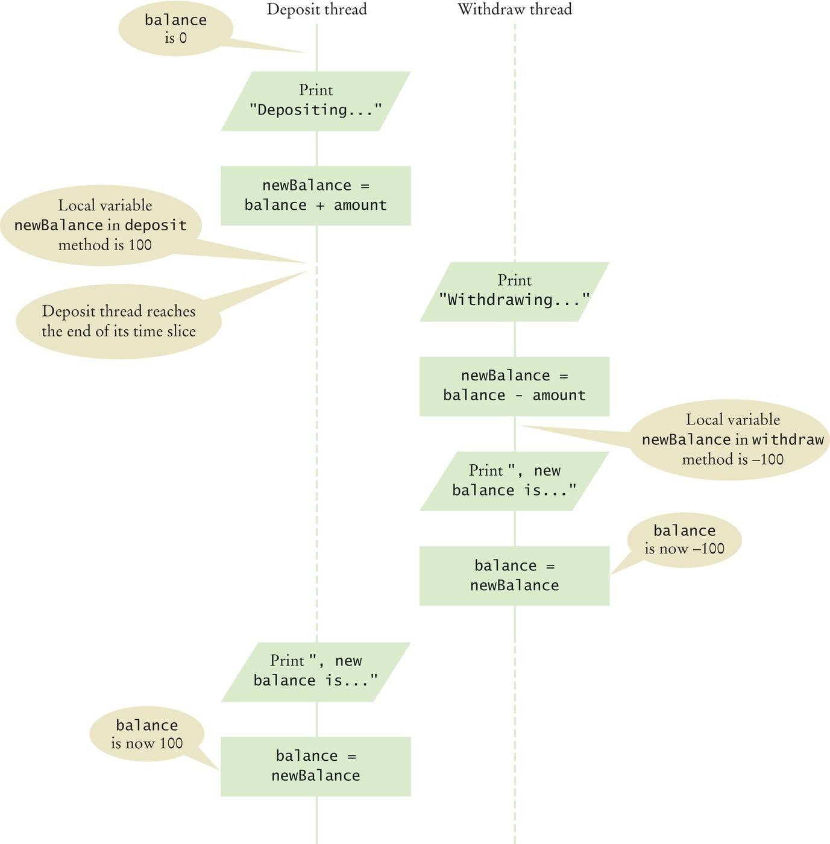
Corrupting the Contents of the
balance Variable
Figure 1 Corrupting the Contents of the balance Variable

Slide 33
Race Condition
Occurs if the effect of multiple threads on shared data depends on the order in which they are scheduled.
It is possible for a thread to reach the end of its time slice in the middle of a statement.
It may evaluate the right-hand side of an equation but not be able to store the result until its next turn:
public void deposit(double amount)
{
balance = balance + amount; System.out.print("Depositing " + amount
+ ", new balance is " + balance);
}
Race condition can still occur:
balance = the right-hand-side value

Slide 34
section_3/BankAccountThreadRunner.java
1 /**
This program runs threads that deposit and withdraw
money from the same bank account.
4 */
5 public class BankAccountThreadRunner
6 {
7 public static void main(String[] args)
8 {
BankAccount account = new BankAccount();
final double AMOUNT = 100;
final int REPETITIONS = 100;
final int THREADS = 100;
13
14
15
16
17
18
for (int i = 1; i <= THREADS; i++)
{
DepositRunnable d = new DepositRunnable( account, AMOUNT, REPETITIONS);
WithdrawRunnable w = new WithdrawRunnable(
19 |  |  |  | account, | AMOUNT, REPETITIONS);
20
21 |  |  |  | Thread dt = | new Thread(d);
22 |  |  |  | Thread wt = | new Thread(w);
23
24 |  |  |  | dt.start();
25 |  |  |  | wt.start();
26 |  |  | }
27 |  | }
28 | }

Slide 35
section_3/DepositRunnable.java
/**
Constructs a deposit runnable.
@param anAccount the account into which to deposit money
@param anAmount the amount to deposit in each repetition
@param aCount the number of repetitions
*/
public DepositRunnable(BankAccount anAccount, double anAmount, int aCount)
{
account = anAccount; amount = anAmount; count = aCount;
}
1 /**
2 A deposit runnable makes periodic deposits to a bank account.
3 */
4 public class DepositRunnable implements Runnable
5 {
private static final int DELAY = 1;
private BankAccount account;
private double amount;
private int count;
10
11
12
13
14
15
16
17
18
19
20
21
22
23
24
25
26
27
28
public void run()
{
try
{

Slide 36
29
30
31
32
33
34
35
for (int i = 1; i <= count; i++)
{
account.deposit(amount); Thread.sleep(DELAY);
}
}
catch (InterruptedException exception) {}

Slide 37
section_3/WithdrawRunnable.java
/**
Constructs a withdraw runnable.
@param anAccount the account from which to withdraw money
@param anAmount the amount to withdraw in each repetition
@param aCount the number of repetitions
*/
public WithdrawRunnable(BankAccount anAccount, double anAmount, int aCount)
{
account = anAccount; amount = anAmount; count = aCount;
}
1 /**
2 A withdraw runnable makes periodic withdrawals from a bank account.
3 */
4 public class WithdrawRunnable implements Runnable
5 {
private static final int DELAY = 1;
private BankAccount account;
private double amount;
private int count;
10
11
12
13
14
15
16
17
18
19
20
21
22
23
24
25
26
27
28
public void run()
{
try
{

Slide 38
29
30
31
32
33
34
35
for (int i = 1; i <= count; i++)
{
account.withdraw(amount); Thread.sleep(DELAY);
}
}
catch (InterruptedException exception) {}

Slide 39
section_3/BankAccount.java
1 /**
A bank account has a balance that can be changed by
deposits and withdrawals.
4 */
5 public class BankAccount
6 {
7 private double balance;
8
9
10
11
12
13
14
15
16
17
18
19
20
21
22
23
24
25
/**
Constructs a bank account with a zero balance.
*/
public BankAccount()
{
balance = 0;
}
/**
Deposits money into the bank account.
@param amount the amount to deposit
*/
public void deposit(double amount)
{
System.out.print("Depositing " + amount); double newBalance = balance + amount;
System.out.println(", new balance is " + newBalance);
Program Run:

Slide 40
Depositing 100.0, new balance is 100.0
Withdrawing 100.0, new balance is 0.0
Depositing 100.0, new balance is 100.0
Withdrawing 100.0, new balance is 0.0
.. .
Withdrawing 100.0, new balance is 400.0
Depositing 100.0, new balance is 500.0
Withdrawing 100.0, new balance is 400.0
Withdrawing 100.0, new balance is 300.0

Slide 41
Self Check 22.5
Give a scenario in which a race condition causes the bank balance to be
–100 after one iteration of a deposit thread and a withdraw thread.
Answer: There are many possible scenarios. Here is one:
The first thread loses control after the first print
statement.
The second thread loses control just before the assignment balance = newBalance.
The first thread completes the deposit method.
The second thread completes the withdraw
method.

Slide 42
Self Check 22.6
Suppose two threads simultaneously insert objects into a linked list. Using the implementation in Chapter 16, explain how the list can be damaged in the process.
Answer: One thread calls addFirst and is preempted just before executing the assignment first = newNode. Then the next thread calls addFirst, using the old value of first. Then the first thread completes the process, setting first to its new node. As a result, the links are not in sequence.

Slide 43
Synchronizing Object Access
To solve problems such as the one just seen, use a
lock object.
Lock object: used to control threads that manipulate shared resources.
In Java library: Lock interface and several classes that implement it.
ReentrantLock: most commonly used lock class. Locks are a feature of Java version 5.0.
Earlier versions of Java have a lower-level facility for thread synchronization.

Slide 44
Synchronizing Object Access
Typically, a Lock object is added to a class whose methods access shared resources, like this:
public class BankAccount
{
private Lock balanceChangeLock;
. . .
public BankAccount()
{
balanceChangeLock = new ReentrantLock();
. . .
}
. . .
}

Slide 45
Synchronizing Object Access
Code that manipulates shared resource is surrounded by calls to lock and unlock:
balanceChangeLock.lock(); Manipulate the shared resource. balanceChangeLock.unlock();
If code between calls to lock and unlock throws an exception, call to unlock never happens.

Slide 46

Visualizing Object Locks
Figure 2 Visualizing Object Locks

Slide 47
Synchronizing Object Access
To overcome this problem, place call to unlock into a finally clause:
balanceChangeLock.lock(); try
{
Manipulate the shared resource.
}
finally
{
balanceChangeLock.unlock();
}

Slide 48
Synchronizing Object Access
Code for deposit method:
public void deposit(double amount)
{
balanceChangeLock.lock(); try
{
System.out.print("Depositing " + amount); double newBalance = balance + amount; System.out.println(", new balance is "
+ newBalance); balance = newBalance;
}
finally
{
balanceChangeLock.unlock();
}
}

Slide 49
Synchronizing Object Access
When a thread calls lock, it owns the lock until it calls unlock.
A thread that calls lock while another thread owns the lock is temporarily deactivated.
Thread scheduler periodically reactivates thread so it can try to acquire the lock.
Eventually, waiting thread can acquire the lock.

Slide 50
Self Check 22.7
If you construct two BankAccount objects, how many lock objects are created?
Answer: Two, one for each bank account object. Each lock protects a separate balance variable.

Slide 51
Self Check 22.8
What happens if we omit the call unlock at the end of the deposit
method?
Answer: When a thread calls deposit, it continues to own the lock, and any other thread trying to deposit or withdraw money in the same bank account is blocked forever.

Slide 52
Avoiding Deadlocks
A deadlock occurs if no thread can proceed because each thread is waiting for another to do some work first.
BankAccount example:
public void withdraw(double amount)
{
balanceChangeLock.lock(); try
{
while (balance < amount)
Wait for the balance to grow
...
}
finally
{
balanceChangeLock.unlock();
}
}

Slide 53
Avoiding Deadlocks
How can we wait for the balance to grow?
We can’t simply call sleep inside withdraw method; thread will block all other threads that want to use balanceChangeLock.
In particular, no other thread can successfully execute deposit.
Other threads will call deposit, but will be blocked until withdraw exits.
But withdraw doesn’t exit until it has funds available.
DEADLOCK.

Slide 54
Condition Objects
To overcome problem, use a condition object. Condition objects allow a thread to temporarily release a lock, and to regain the lock at a later time.
Each condition object belongs to a specific lock object.

Slide 55
Condition Objects
You obtain a condition object with newCondition
method of Lock interface:
public class BankAccount
{
private Lock balanceChangeLock;
private Condition sufficientFundsCondition;
. . .
public BankAccount()
{
balanceChangeLock = new ReentrantLock(); sufficientFundsCondition =
balanceChangeLock.newCondition();
. . .
}
}

Slide 56
Condition Objects
It is customary to give the condition object a name that describes condition to test; e.g. “sufficient funds”. You need to implement an appropriate test.

Slide 57
Condition Objects
As long as test is not fulfilled, call await on the condition object:
public void withdraw(double amount)
{
balanceChangeLock.lock(); try
{
while (balance < amount)
{
sufficientFundsCondition.await();
}
. . .
}
finally
{
balanceChangeLock.unlock();
}
}

Slide 58
Condition Objects
Calling await:
Makes current thread wait.
Allows another thread to acquire the lock object.
To unblock, another thread must execute
signalAll on the same condition object:
sufficientFundsCondition.signalAll();
signalAll unblocks all threads waiting on the condition.
signal randomly picks just one thread waiting on the object and unblocks it.
signal can be more efficient, but you need to know that every waiting thread can proceed.
Recommendation: always call signalAll.

Slide 59
section_5/BankAccount.java
import java.util.concurrent.locks.Condition;
import java.util.concurrent.locks.Lock;
import java.util.concurrent.locks.ReentrantLock;
4
5
6
7
8
9
10
11
12
13
14
15
16
17
18
19
20
21
22
23
24
25
26
27
28
/**
A bank account has a balance that can be changed by deposits and withdrawals.
*/
public class BankAccount
{
private double balance;
private Lock balanceChangeLock;
private Condition sufficientFundsCondition;
/**
Constructs a bank account with a zero balance.
*/
public BankAccount()
{
balance = 0;
balanceChangeLock = new ReentrantLock(); sufficientFundsCondition = balanceChangeLock.newCondition();
}
/**
Deposits money into the bank account.
@param amount the amount to deposit
*/

Slide 60
29
30
31
32
33
34
35
public void deposit(double amount)
{
balanceChangeLock.lock(); try
{
System.out.print("Depositing " + amount); double newBalance = balance + amount;

Slide 61
section_5/BankAccountThreadRunner.java
1 /**
This program runs threads that deposit and withdraw
money from the same bank account.
4 */
5 public class BankAccountThreadRunner
6 {
7 public static void main(String[] args)
8 {
BankAccount account = new BankAccount();
final double AMOUNT = 100;
final int REPETITIONS = 100;
final int THREADS = 100;
13
14
15
16
17
18
19
20
21
22
23
24
25
for (int i = 1; i <= THREADS; i++)
{
DepositRunnable d = new DepositRunnable( account, AMOUNT, REPETITIONS);
WithdrawRunnable w = new WithdrawRunnable(
account, AMOUNT, REPETITIONS);
Thread dt = new Thread(d); Thread wt = new Thread(w);
dt.start();
wt.start();
26 }
Program Run:

Slide 62
Depositing 100.0, new balance is 100.0
Withdrawing 100.0, new balance is 0.0
Depositing 100.0, new balance is 100.0
Depositing 100.0, new balance is 200.0
.. .
Withdrawing 100.0, new balance is 100.0
Depositing 100.0, new balance is 200.0
Withdrawing 100.0, new balance is 100.0
Withdrawing 100.0, new balance is 0.0

Slide 63
Self Check 22.9
What is the essential difference between calling sleep and await?
Answer: A sleeping thread is reactivated when the sleep delay has passed. A waiting thread is only reactivated if another thread has called signalAll or signal.

Slide 64
Self Check 22.10
Why is the sufficientFundsCondition object an instance variable of the BankAccount class and not a local variable of the withdraw and deposit methods?
Answer: The calls to await and signal/signalAll must be made to the same object.

Slide 65
Application: Algorithm Animation
Animation shows different objects moving or changing as time progresses.
Often achieved by launching one or more threads that compute how parts of the animation change.
Can use Swing Timer class for simple animations. More advanced animations are best implemented with threads.
Algorithm animation helps visualize the steps in the algorithm.

Slide 66
Algorithm Animation
Runs in a separate thread that periodically updates an image of the current state of the algorithm.
Then pauses so the user can view the image.
After a short time the algorithm thread wakes up and runs to the next point of interest.
Updates the image again and pauses again. Repeats sequence until algorithm has finished.

Slide 67
Selection Sort Algorithm Animation
Items in the algorithm’s state:
The array of values.
The size of the already sorted area. The currently marked element.
This state is accessed by two threads:
One that sorts the array, and One that repaints the frame.
To visualize the algorithm:
Show the sorted part of the array in a different color. Mark the currently visited array element in red.

Slide 68
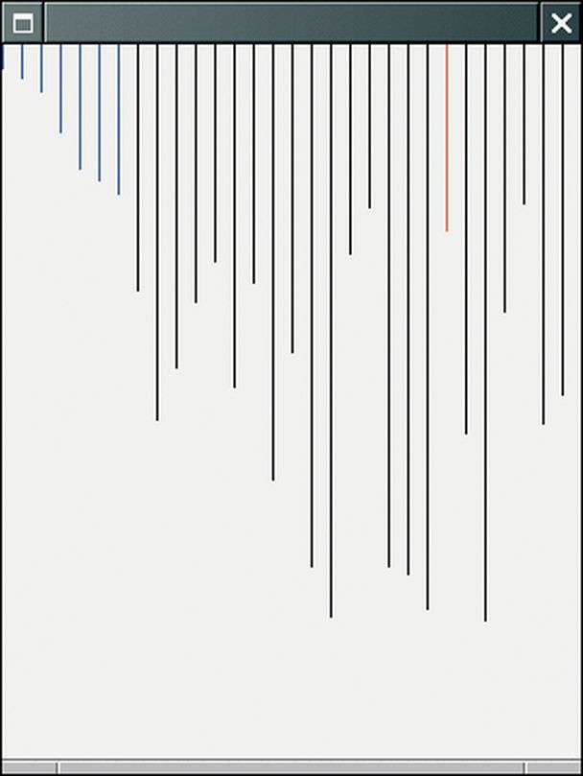
Selection Sort Algorithm Animation Step
Figure 3 Selection Sort Algorithm Animation Step

Slide 69
Selection Sort Algorithm Animation: Implementation
Add state to the SelectionSorter class:
public class SelectionSorter
{
// This array is being sorted private int[] a;
// These instance variables are needed for drawing private int markedPosition = -1;
private int alreadySorted = -1;
. . .
}
Add a component to the class for repainting the algorithm state:
public class SelectionSorter
{
private JComponent component;
public SelectionSorter(int[] anArray, Jcomponent aComponent)
{
a = anArray;
sortStateLock = new ReentrantLock(); component = aComponent;
}
...
}

Slide 70
Selection Sort Algorithm Animation: Implementation
At each point of interest, algorithm needs to pause so user can observe the graphical output.
We need a pause method that repaints component and sleeps for a small delay:
public void pause(int steps) throws InterruptedException
{
component.repaint(); Thread.sleep(steps * DELAY);
}
DELAY is proportional to the number of steps involved.
pause should be called at various places in the algorithm.

Slide 71
Selection Sort Algorithm Animation: Implementation
We add a draw method to the algorithm class.
draw draws the current state of the data structure, highlighting items of special interest.
draw is specific to the particular algorithm.
In this case, draws the array elements as a sequence of sticks in different colors:
The already sorted portion is blue. The marked position is red.
The remainder is black.

Slide 72
Selection Sort Algorithm Animation: draw Method
public void draw(Graphics2D g2)
{
sortStateLock.lock(); try
{
int deltaX = component.getWidth() / a.length; for (int i = 0; i < a.length; i++)
{
if (i == markedPosition)
{
g2.setColor(Color.RED);
}
else if (i <= alreadySorted)
{
g2.setColor(Color.BLUE);
}
else
{
g.setColor(Color.BLACK);
}
g.drawLine(i * deltaX, 0, i * deltaX, a[i]);
}
}
finally
{
sortStateLock.unlock();
}
}

Slide 73
Selection Sort Algorithm Animation: Pausing
Update the special positions as the algorithm progresses.
Pause the animation whenever something interesting happens.
Pause should be proportional to the number of steps that are being executed.
In this case, pause one unit for each visited array element.
Augment minimumPosition and sort accordingly.

Slide 74
Selection Sort Algorithm Animation: Constructing and Animating
SelectionSortComponent constructor constructs a SelectionSorter object.
Using a new array and the this reference to the component that displays the sorted values:
public SelectionSortComponent()
{
int[] values = ArrayUtil.randomIntArray(30, 300); sorter = new SelectionSorter(values, this);
}
startAnimation method constructs a thread that calls the sorter’s sort method:
public void startAnimation()
{
class AnimationRunnable implements Runnable

Slide 75
{
public void run()
{
try
{
sorter.sort();
}
catch (InterruptedException exception)
{
}
}
}
Runnable r = new AnimationRunnable(); Thread t = new Thread(r);
t.start();
}

Slide 76
section_6/SelectionSortViewer.java
import java.awt.BorderLayout;
import javax.swing.JButton;
import javax.swing.JFrame;
4
5
6
7
8
9
10
11
12
13
14
15
16
17
18
19
20
21
22
23
24 }
public class SelectionSortViewer
{
public static void main(String[] args)
{
JFrame frame = new JFrame();
final int FRAME_WIDTH = 300; final int FRAME_HEIGHT = 400;
frame.setSize(FRAME_WIDTH, FRAME_HEIGHT); frame.setDefaultCloseOperation(JFrame.EXIT_ON_CLOSE);
final SelectionSortComponent component
= new SelectionSortComponent(); frame.add(component, BorderLayout.CENTER);
frame.setVisible(true); component.startAnimation();
}

Slide 77
section_6/SelectionSortComponent.java
import java.awt.Graphics;
import javax.swing.JComponent;
3
4 /**
5 A component that displays the current state of the selection sort algorithm.
6 */
7 public class SelectionSortComponent extends JComponent
8 {
9 private SelectionSorter sorter;
10
11
12
13
14
15
16
17
18
19
20
21
22
23
24
25
26
27
28
/**
Constructs the component.
*/
public SelectionSortComponent()
{
int[] values = ArrayUtil.randomIntArray(30, 300); sorter = new SelectionSorter(values, this);
}
public void paintComponent(Graphics g)
{
sorter.draw(g);
}
/**
Starts a new animation thread.
*/
public void startAnimation()

Slide 78
29 | {
30 |  | class AnimationRunnable implements Runnable
31 |  | {
32 |  | public void run()
33 |  | {
34 |  | try
35 |  | {

Slide 79
section_6/SelectionSorter.java
import java.awt.Color;
import java.awt.Graphics;
import java.util.concurrent.locks.Lock;
import java.util.concurrent.locks.ReentrantLock;
import javax.swing.JComponent;
6
7
8
9
10
11
12
13
14
15
16
17
18
19
20
21
22
23
24
25
26
27
28
/**
This class sorts an array, using the selection sort algorithm.
*/
public class SelectionSorter
{
// This array is being sorted
private int[] a;
// These instance variables are needed for drawing
private int markedPosition = -1; private int alreadySorted = -1;
private Lock sortStateLock;
// The component is repainted when the animation is paused
private JComponent component;
private static final int DELAY = 100;
/**
Constructs a selection sorter.
@param anArray the array to sort
@param aComponent the component to be repainted when the animation

Slide 80
29
30
31
32
33
34
pauses
*/
public SelectionSorter(int[] anArray, JComponent aComponent)
{
a = anArray;
sortStateLock = new ReentrantLock();

Slide 81
Self Check 22.11
Why is the draw method added to the SelectionSorter class and not the SelectionSortComponent class?
Answer: The draw method uses the array values and the values that keep track of the algorithm’s progress. These values are available only in the SelectionSorter class.

Slide 82
Self Check 22.12
Would the animation still work if the startAnimation method simply called sorter.sort() instead of spawning a thread that calls that method?
Answer: Yes, provided you only show a single frame. If you modify the SelectionSortViewer program to show two frames, you want the sorters to run in parallel.

